Slide 1
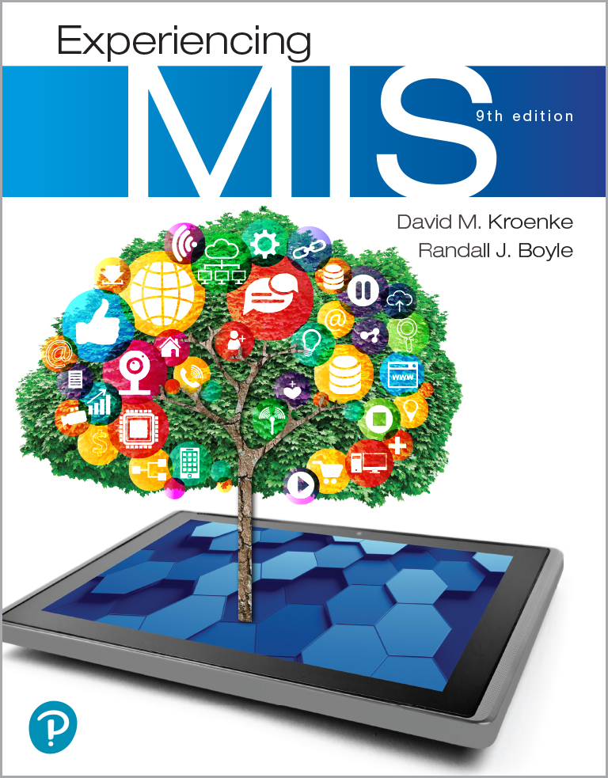
Experiencing M I S
Ninth Edition
Chapter 10
Information Systems Security
Slides in this presentation contain hyperlinks. JAWS users should be able to get a list of links by using INSERT+F7
Copyright © 2021, 2019, 2017 Pearson Education, Inc. All Rights Reserved
Notes:
If this PowerPoint presentation contains mathematical equations, you may need to check that your computer has the following installed:
1) MathType Plugin
2) Math Player (free versions available)
3) NVDA Reader (free versions available)
This chapter provides an overview of the major components of information systems security.

Slide 2
“I Think You’ll See That We Really Do Take Security Seriously.” (1 of 2)
Video conference with exercise equipment manufacturer CanyonBack Fitness (potential A R E S partner).
Security concerns about integrating A R E S with CanyonBack exercise bikes.
Does A R E S systems have acceptable level of security?
Can their bikes get hacked? Customers hurt? Personal data stolen?
Notes:
GOALS
Illustrate the meaning of design for privacy and security.
Set up a class discussion about how much technical language to use in management/IS professional meetings.

Slide 3
“I Think You’ll See That We Really Do Take Security Seriously.” (2 of 2)
A R E S implements secure coding practices and secure data backup.
Users interact with radio buttons, dropdown menus, and other interactive A R elements.
Reduces the possibility of an S Q L injection attack.
New technology typically brings new risks.

Slide 4
Study Questions
10-1 What is the goal of information systems security?
10-2 How big is the computer security problem?
10-3 How should you respond to security threats?
10-4 How should organizations respond to security threats?
10-5 How can technical safeguards protect against security threats?
10-6 How can data safeguards protect against security threats?
10-7 How can human safeguards protect against security threats?
10-8 How should organizations respond to security incidents?

Slide 5
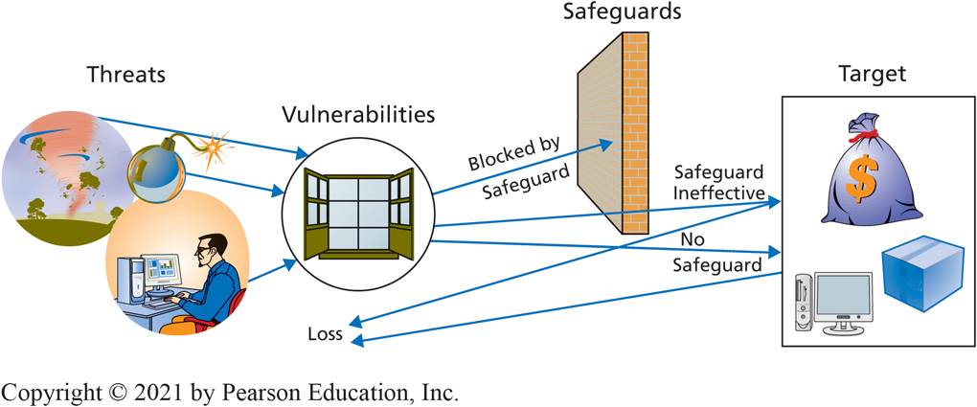
Information Systems Security Threats
10-1 What is the goal of information systems security?
Figure 10-1 Threat/Loss Scenario
Notes:
Threat/Loss Scenario: Major elements of IS security
Threat—person or organization seeks to obtain data or other assets illegally, without owner’s permission and often without owner’s knowledge
Vulnerability—opportunity for threats to gain access to individual or organizational assets; for example, when you buy online, you provide your credit card data, and as data is transmitted over Internet, it is vulnerable to threats
Safeguard—measure individuals or organizations take to block threat from obtaining an asset; not always effective, some threats achieve their goal in spite of safeguards
Target—asset desired by threat

Slide 6
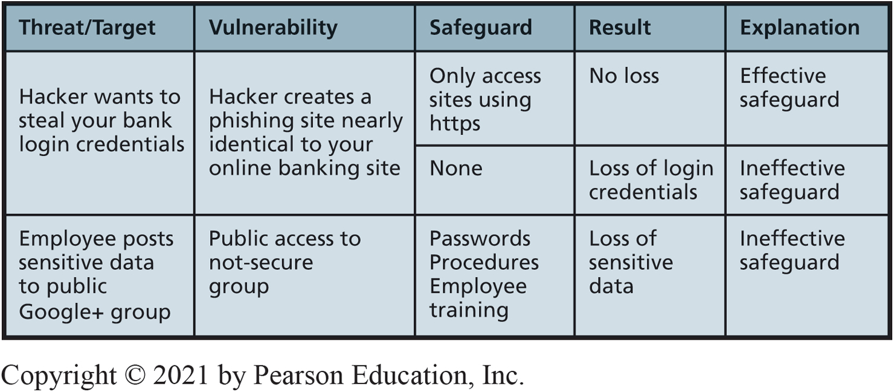
Examples of Threat/Loss
10-1 What is the goal of information systems security?
Figure 10-2 Examples of Threat/Loss
Notes:
If you access what appears to be your bank’s site without using https (i.e., an unsecured site), you have no safeguard at all. Your login credentials can be quickly recorded and resold to other criminals.
The employer has procedures that state employees are not to post confidential data to any public site, such as Google+, but these procedures were either unknown or ignored.
A third safeguard is the training that all employees are given.

Slide 7
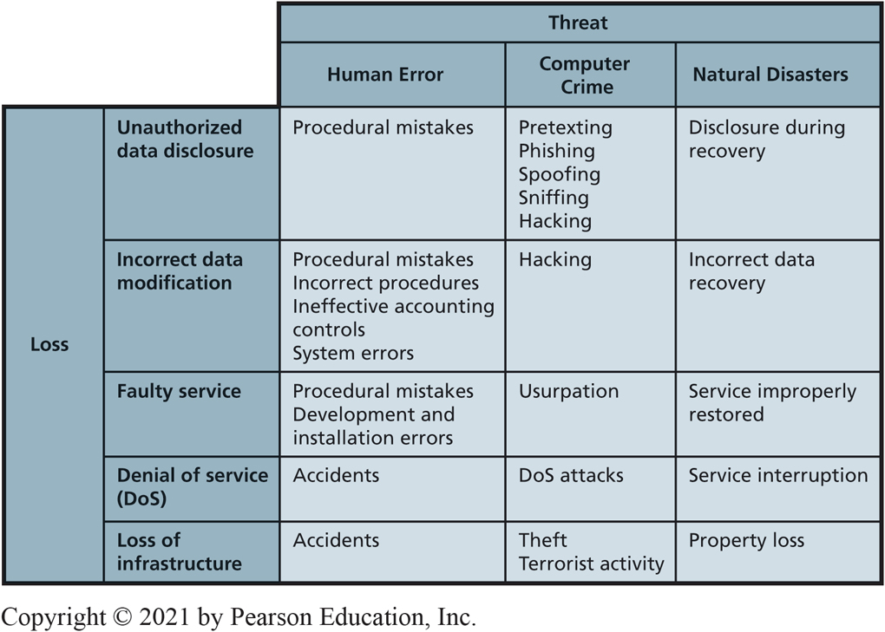
What are the Sources of Threats?
10-1 What is the goal of information systems security?
Figure 10-3 Security Problems and Sources
Notes:
Sources of security threats:
Human error examples: (1) employee misunderstands operating procedures and accidentally deletes customer records; (2) employee inadvertently installs an old database on top of current one while doing backing up; (3) physical accidents, such as driving a forklift through wall of a computer room
Computer crime—intentional destruction or theft of data or other system components
Natural disasters—fires, floods, hurricanes, earthquakes, tsunamis, avalanches, other acts of nature; includes initial loss of capability and service, and losses recovery costs

Slide 8
What Types of Security Loss Exists?
10-1 What is the goal of information systems security?
Unauthorized Data Disclosure
Pretexting
Phishing
Spoofing
I P spoofing
Email spoofing
Sniffing
Wardrivers
Hacking
Natural disasters
Notes:
These are common threats associated with unauthorized data disclosure.

Slide 9
Incorrect Data Modification
10-1 What is the goal of information systems security?
Procedures incorrectly designed or not followed.
Increasing customer’s discount or incorrectly modifying employee’s salary.
Placing incorrect data on company Web site.
Cause
Improper internal controls on systems.
System errors.
Faulty recovery actions after a disaster.

Slide 10
Faulty Service
10-1 What is the goal of information systems security?
Incorrect data modification
Systems working incorrectly
Procedural mistakes
Programming errors
I T installation errors
Usurpation
Denial of service (unintentional)
Denial-of-service attacks (intentional)
Notes:
Faulty service—problems caused by incorrect system operation
Usurpation—occurs when computer criminals invade a computer system and replace legitimate programs with their own unauthorized ones that shut down legitimate application and substitute their own processing to spy, steal and manipulate data, or other purposes
Denial of service—humans inadvertently shut down a Web server or corporate gateway router by starting a computationally intensive application
Denial-of-service attacks—(1) malicious hacker intentionally floods a Web server with millions of bogus service requests; (2) user unintentionally shuts down Web server or corporate gateway router by starting computationally intensive application

Slide 11
Loss of Infrastructure
10-1 What is the goal of information systems security?
Human accidents
Theft and terrorist events
Disgruntled or terminated employee
Natural disasters
Advanced Persistent Threat
A P T 37 and Reaper (North Korea)
Attacked strategic political targets in South Korea, Japan, Vietnam, and the Middle East
Notes:
Examples—bulldozer cutting a conduit of fiber-optic cables or floor buffer crashing into a rack of Web servers.
APT37 and Reaper from N Korea.
In 2018, APT37 used zero-day vulnerabilities to attack the South Korean military, government, and defense industries. APT37 then expanded operations to include strategic political targets in Japan, Vietnam, and the Middle East.

Slide 12
Goal of Information Systems Security
10-1 What is the goal of information systems security?
Find appropriate trade-off between risk of loss and cost of implementing safeguards.
Protective actions.
Use antivirus software.
Delete browser cookies?
Make appropriate trade-offs to protect yourself and your business.

Slide 13
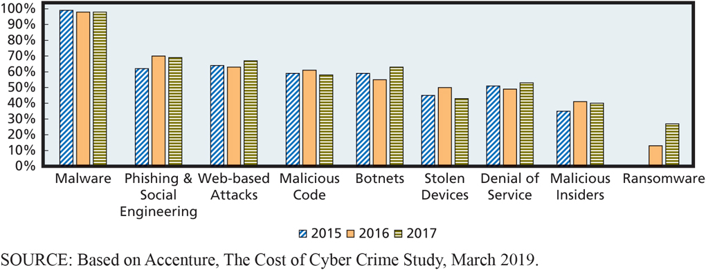
Average Computer Crime Cost and Percent of Attacks by Type
10-2 How big is the computer security problem?
Figure 10-4 Percent of Companies Experiencing Attacks by Attack Type
Notes:
Figure 10-4 shows the results of a survey performed by Accenture and the Ponemon Institute, a consulting group that specializes in computer crime.
It shows the percentage of companies experiencing the most common types of attacks.
Malware is the most common type of attack (98%).

Slide 14
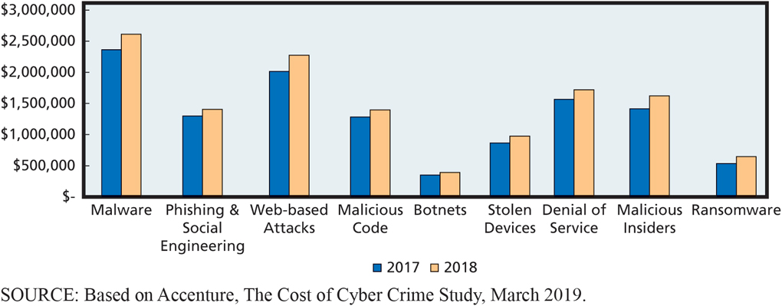
Severity of Computer Crime
10-2 How big is the computer security problem?
Figure 10-5 Average Annual Computer Crime Costs by Attack Type
Notes:
Figure 10-5 Ponemon study.

Slide 15
Accenture Study Findings (2019)
10-2 How big is the computer security problem?
Ransomware and malicious insider attacks are increasingly serious security threats.
Information loss and business disruption are principal costs of computer crime.
Discovery and containment account for over half of the internal costs related to cyber intrusions.
Security safeguards work.
Notes:
Warn students that many computer crime studies are based on dubious sampling techniques, and some seem to be written to promote a particular safeguard product or point of view. Be aware of such bias as you read.

Slide 16
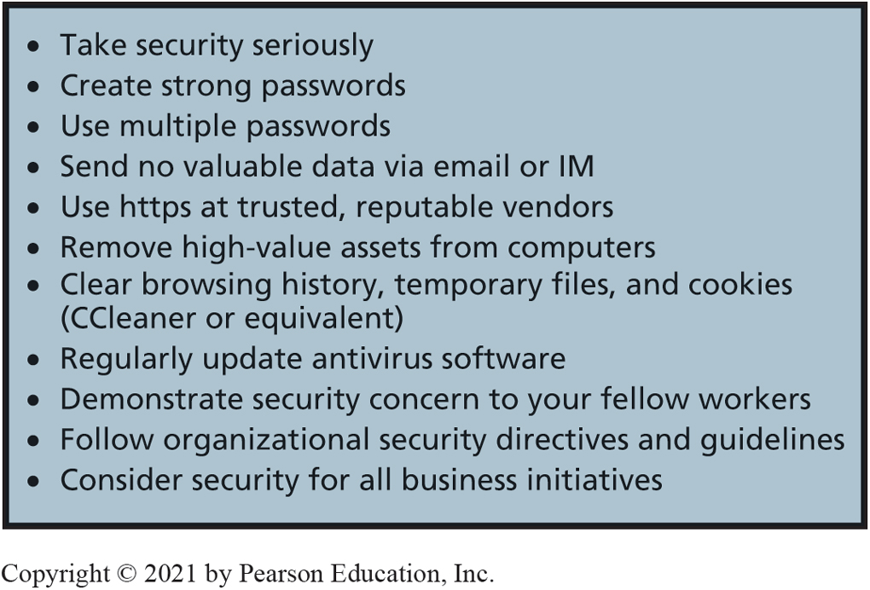
Personal Security Safeguards
10-3 How should you respond to security threats?
Figure 10-6 Personal Security Safeguards
Notes:
Computer security professionals run intrusion detection systems to detect attacks. An intrusion detection system (IDS) is a computer program that senses when another computer is attempting to scan or access a computer or network.
IDS logs can record thousands of attempts each day.

Slide 17
Security Policies
10-4 How should organizations respond to security threats?
Senior management creates company-wide policies:
What sensitive data will be stored?
How will data be processed?
Will data be shared with other organizations?
How can employees and others obtain copies of data stored about them?
How can employees and others request changes to inaccurate data?
Senior management manages risks.
Notes:
Specifics of a policy depend on whether the organization is governmental or nongovernmental, publicly held or private, organization’s industry, relationship of management to employees, and other factors.
Senior management must establish company-wide security policies.
Senior management security function is to manage risk.

Slide 18
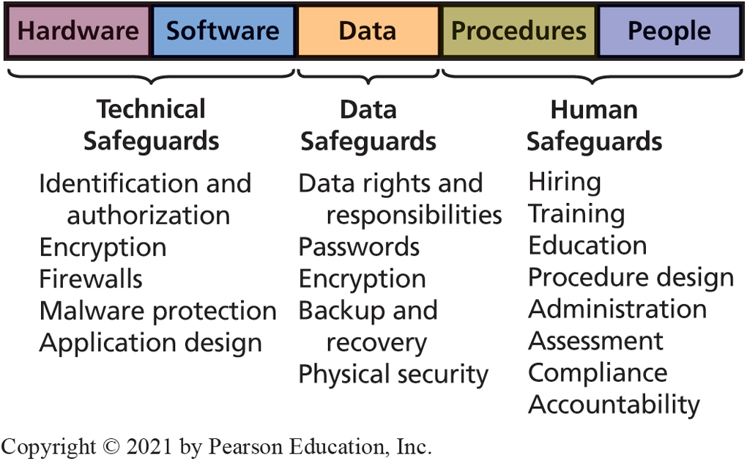
Security Safeguards and the Five Components
10-4 How should organizations respond to security threats?
Figure 10-7 Security Safeguards as They Relate to the Five Components
Notes:
An easy way to remember information systems safeguards is to arrange them according to the five components of an information system.

Slide 19
Largest! Data! Breach! Ever!
So What?
October 2017 Yahoo! announced extent of breach.
3 billion user accounts compromised.
Took over 3 years for Yahoo! to disclose.
Email addresses, names, phone numbers, hashed password, security questions/answers.
Hackers working with Russian spies.
What effect does this have on Yahoo!?
Notes:
Hacking IoT, hacking cars, vulnerabilities

Slide 20
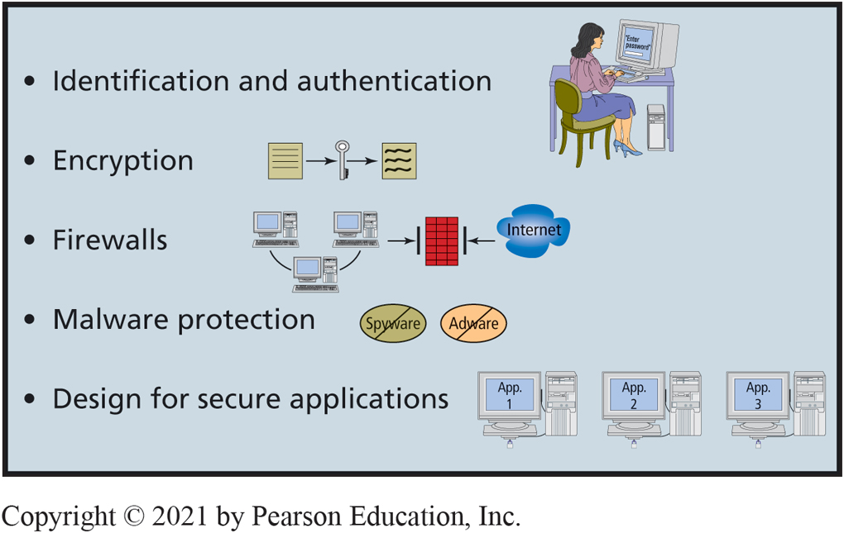
Technical Safeguards
10-5 How can technical safeguards protect against security threats?
Figure 10-8 Technical Safeguards
Notes:
Technical safeguards involve the hardware and software components of an information system.
Single Sign-on for Multiple Systems

Slide 21
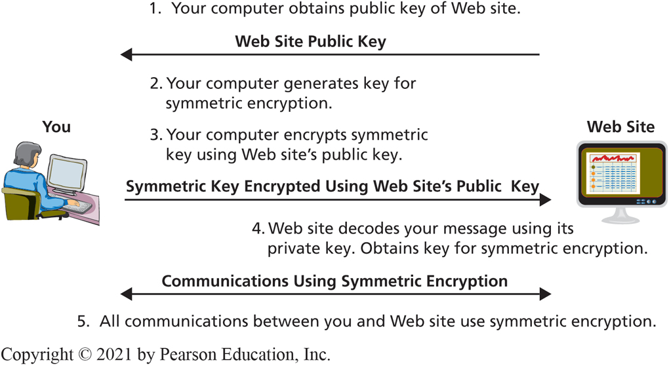
The Essence of h t t p s (S S L or T L S)
10-5 How can technical safeguards protect against security threats?
Figure 10-9 The Essence of https (S S L or T L S)
Notes:
Summary of how SSL/TLS works when you communicate securely with a Web site:
1. Your computer obtains public key of Web site to which it will connect.
2. Your computer generates a key for symmetric encryption.
3. Your computer encodes key using Web site’s public key, then sends encrypted symmetric key to Web site.
4. Web site decodes symmetric key using its private key.
5. Now, your computer and Web site communicate using symmetric encryption.
Note: With asymmetric encryption, two keys are used; one key encodes the message, and the other key decodes the message. Symmetric encryption is simpler and much faster than asymmetric encryption.

Slide 22
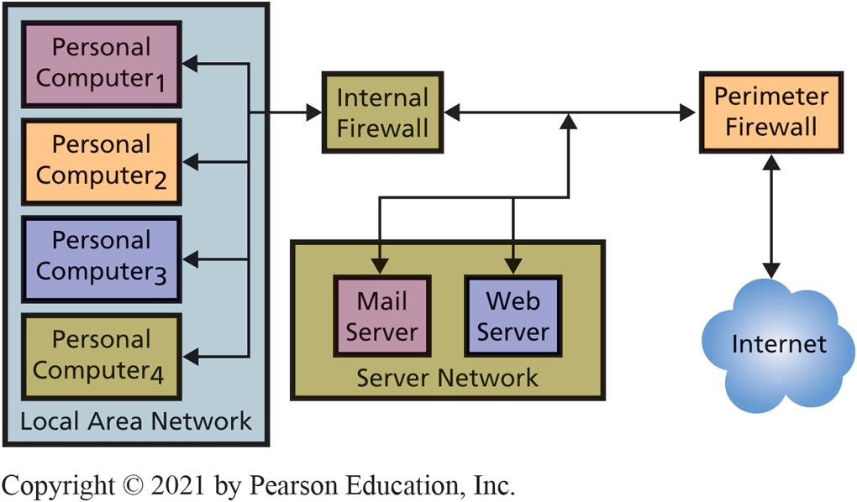
Use of Multiple Firewalls
10-5 How can technical safeguards protect against security threats?
Figure 10-10 Use of Multiple Firewalls
Notes:
Organizations normally use multiple firewalls. Perimeter firewall sits outside organizational network; is first device that Internet traffic encounters.
Packet-filtering firewall examines each part of a message and determines whether to let that part pass. To make this decision, it examines source address, destination address(es), and other data. Packet-filtering firewalls can prohibit outsiders from starting a session with any user behind firewall, prohibit traffic from legitimate, but unwanted, addresses, such as competitors’ computers, and filter outbound traffic.
No computer should connect to the Internet without firewall protection. Many ISPs provide firewalls for their customers. By nature, these firewalls are generic. Large organizations supplement such generic firewalls with their own. Most home routers include firewalls, and Microsoft Windows has a built-in firewall as well. Third parties also license firewall products.

Slide 23
Malware Protection (Viruses, Spyware, Adware)
10-5 How can technical safeguards protect against security threats?
Install antivirus and antispyware programs.
Scan frequently.
Update malware definitions.
Open email attachments only from known sources.
Install software updates promptly.
Browse only reputable Internet neighborhoods.

Slide 24
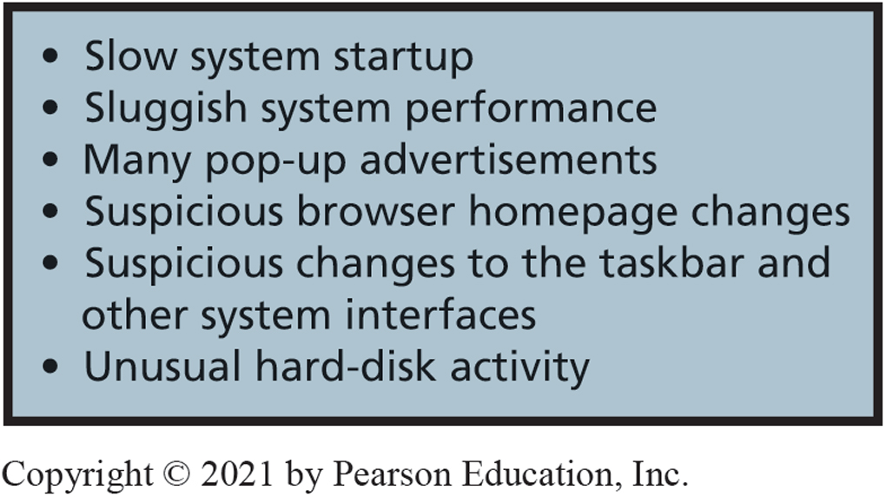
Spyware/Adware Symptoms and Types of Malware
10-5 How can technical safeguards protect against security threats?
Malware
Viruses
Payload
Trojan horses
Worms
Spyware
Keyloggers
Adware
Ransomware
Figure 10-11 Spyware and Adware Symptoms
Notes:
Payload is program code that causes unwanted activity. It can delete programs or data, or modify data in undetected ways.
Spyware programs are installed on the user’s computer without the user’s knowledge or permission. It resides in background and, unknown to the user, observes user’s actions and keystrokes, monitors computer activity, and reports the user’s activities to sponsoring organizations.
Some malicious spyware, called key loggers, captures keystrokes to obtain usernames, passwords, account numbers, and other sensitive information. Other spyware supports marketing analyses such as observing what users do, Web sites visited, products examined and purchased, and so forth.
Most adware is benign in that it does not perform malicious acts or steal data. It does, however, watch user activity and produce pop-up ads. Adware can also change the user’s default window or modify search results and switch the user’s search engine.

Slide 25
Design for Secure Applications
10-5 How can technical safeguards protect against security threats?
S Q L injection attack
User enters S Q L statement into a form instead of a name or other data.
Result
S Q L code becomes part of database commands issued.
Improper data disclosure, data damage and loss possible.
Well designed applications make injections ineffective.
Notes:
ARES with security in mind; ARES will store users’ privacy settings in a database, and it will develop all applications to first read the privacy settings before revealing any data in exercise reports. Most likely, ARES will design its programs so that privacy data is processed by programs on servers, which means data need be transmitted over the Internet only when it is created or modified.

Slide 26
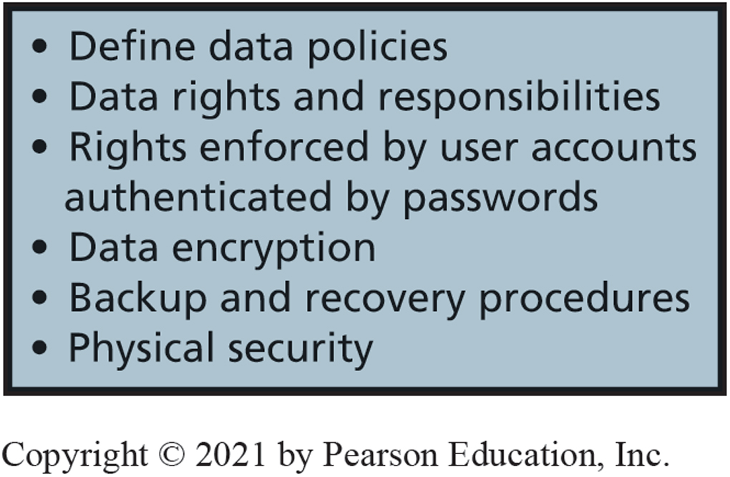
Data Safeguards
10-6 How can data safeguards protect against security threats?
Data safeguards
Data administration
Database administration
Key escrow
Figure 10-12 Data Safeguards
Notes:
Data safeguards protect databases and other organizational data. Two organizational units are responsible for data safeguards.
Data administration refers to an organization-wide function that is in charge of developing data policies and enforcing data standards.
Database administration refers to a function that pertains to a particular database.
When organizations store databases in the cloud, all of the safeguards should be part of the service contract.
Trusted party should have a copy of encryption key—called key escrow.

Slide 27
Legal Safeguards for Data
10-6 How can data safeguards protect against security threats?
Legal standards specify safeguards organizations must follow regarding data collected and stored
Payment Card Industry Data Security Standard (PCI DSS)
Specifies secure storage and processing requirements for credit card data
Gramm-Leach-Bliley Act (GLBA)—protections for consumer financial data stored by financial institutions
Health Insurance Portability and Accountability Act (HIPPA)—standards that govern health data access and protection.
Notes:
Multinational organizations must understand legal safeguards in every country in which they operate

Slide 28
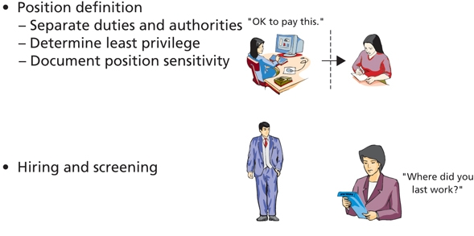
Security Policies for In-House Staff (1 of 2)
10-7 How can human safeguards protect against security threats?
Position definition
Separate duties and authorities
Determine least privilege
Document position sensitivity
Hiring and screening
Figure 10-13 Security Policy for In-House Staff (continues on next slide)
Notes:
Development of human safeguards for employees.

Slide 29
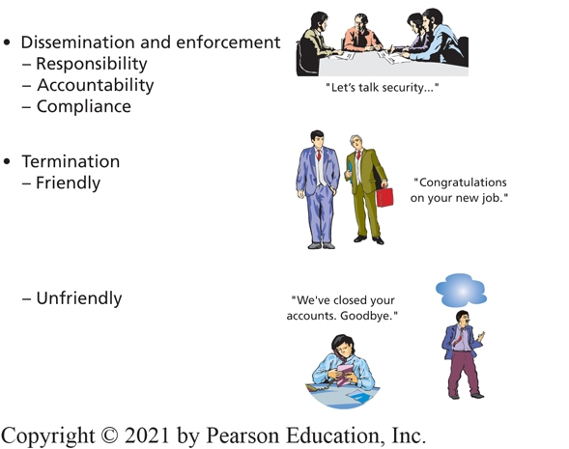
Security Policies for In-House Staff (2 of 2)
10-7 How can human safeguards protect against security threats?
Dissemination and enforcement
Responsibility
Accountability
Compliance
Termination
Friendly
Unfriendly
Figure 10-13 Security Policy for In-House Staff (cont’d.)
Notes:
Development of human safeguards for employees.
Employees need to be made aware of the security policies, procedures, and responsibilities they will have.
Companies must establish security policies and procedures for the termination of employees.

Slide 30
Human Safeguards for Nonemployee Personnel
10-7 How can human safeguards protect against security threats?
Temporary personnel, vendors, partner personnel (employees of business partners), and the public.
Require vendors and partners to perform appropriate screening and security training.
Contract specifies security responsibilities.
Provide accounts and passwords with least privilege and remove accounts as soon as possible.

Slide 31
Public User Considerations
10-7 How can human safeguards protect against security threats?
Public users of Web sites and other openly accessible information systems cannot be held accountable for security violations.
Hardening—reduce the system’s vulnerabilities
Special versions of operating system.
Lock down or eliminate operating systems features and functions not required by application.
Protect such users from internal company security problems.

Slide 32
Account Administration
10-7 How can human safeguards protect against security threats?
Account Management
Standards for new user accounts, modification of account permissions, removal of unneeded accounts.
Password Management
Users change passwords frequently.
Help Desk Policies
Provide means of authenticating users.
Notes:
Account management
Create new user accounts, modify existing account permissions, remove unneeded accounts. Improve your relationship with IS personnel by providing early and timely notification of needed account changes.
Password management
Users should change passwords every 3 months or less.
Help desk management
Set policy for means of authenticating a user.

Slide 33
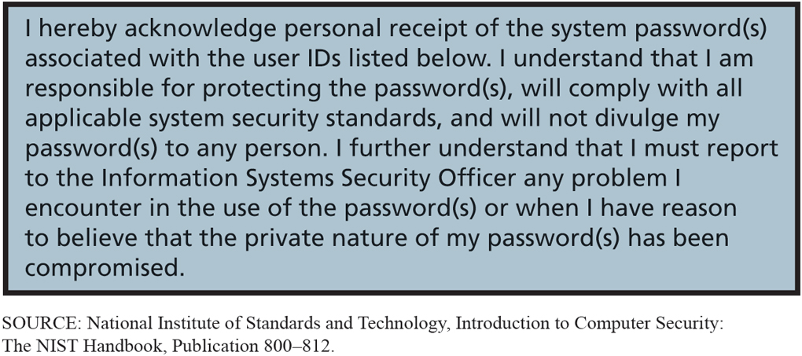
Sample Account Acknowledgement Form
10-7 How can human safeguards protect against security threats?
Figure 10-14 Sample Account Acknowledgement Form
Notes:
Employees required to sign statements similar to this.

Slide 34
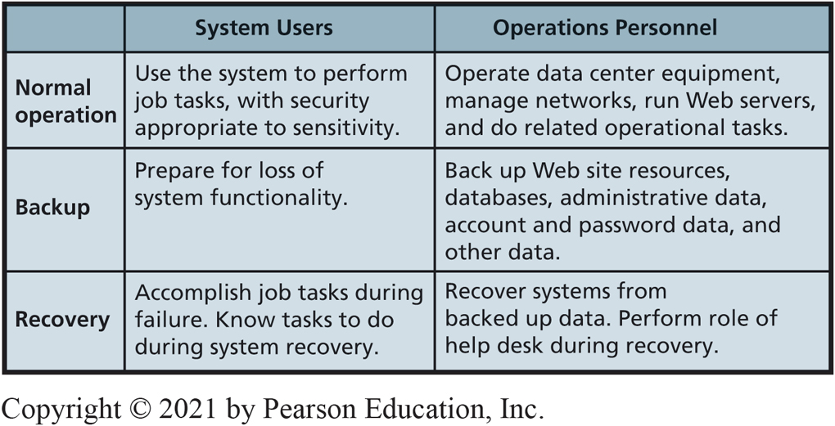
Systems Procedures
10-7 How can human safeguards protect against security threats?
Figure 10-15 Systems Procedures
Notes:
Definition and use of standardized procedures reduces likelihood of computer crime and other malicious activity by insiders. It also ensures system’s security policy is enforced.

Slide 35
Security Monitoring (1 of 2)
10-7 How can human safeguards protect against security threats?
Server activity logs
Firewall log
Lists of all dropped packets, infiltration attempts, unauthorized access, attempts from within the firewall.
D B M S
Successful and failed logins.
Web servers
Voluminous logs of Web activities.
P C O/S produce record of log-ins and firewall activities.

Slide 36
Security Monitoring (2 of 2)
10-7 How can human safeguards protect against security threats?
Employ utilities to assess vulnerabilities.
Honeypots for computer criminals to attack.
Investigate security incidents.
Constantly monitor to determine adequacy of existing security policy and safeguards.

Slide 37
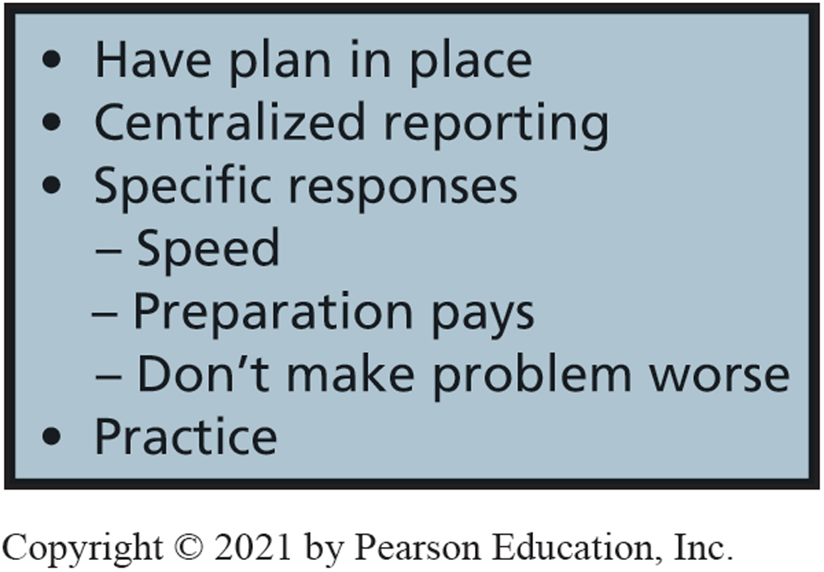
Factors in Incident Response
10-8 How should organizations respond to security incidents?
Figure 10-16 Factors in Incident Response
Notes:
Every organization should have an incident-response plan as part of the security program. No organization should wait until some asset has been lost or compromised before deciding what to do.
The plan should include how employees are to respond to security problems, whom they should contact, the reports to make, and steps to reduce further loss.
Identify critical personnel and their off-hours contact information

Slide 38
How Does the Knowledge in This Chapter Help You?
Awareness of:
Threats to computer security as an individual, business professional, employer
Risk trade offs
Technical, data, human safeguards to protect computing devices and data
How organizations should respond to security threats
How organizations should respond to security incidents
Importance of creating and using strong passwords!

Slide 39
Web Recording Everything (1 of 2)
Ethics Guide
Understand how and why customers make purchase decisions, then customize the site for each visitor to increase purchases.
Web sites are now storing and analyzing everything that visitors do on the site—not just pages they visit or the products that they add to a shopping cart, but all of the mouse movements, keystrokes, and scrolling behavior, too.
Researchers can analyze mouse movement to uncover emotion.
Could be sold to 3rd party.
Notes:
GOALS
Understand ethical considerations, and business consequences of data collection.
Help students formulate personal principles with regard to data acquisition, storage, and dissemination.
Questions
According to the definitions of the ethical principles defined previously in this book:
Do you think covertly monitoring all user behavior on a Web site is ethical according to the categorical imperative?
Do you think covertly monitoring all user behavior on a Web site is ethical according to the utilitarian perspective?
2. Were Robin’s concerns about sharing customer data with a third-party company valid? What kind of problems might arise from sharing this type of data?

Slide 40
Web Recording Everything (2 of 2)
Ethics Guide
Business professionals must consider legality, ethics, and wisdom when collecting private data.
Think carefully about email you open over public, wireless networks.
Use long, strong passwords.
If unsure, don’t give the data.
Notes:
The bottom line is this: Be careful where you put your personal data. Large, reputable organizations are likely to endorse ethical privacy policy, and have strong and effective safeguards to support that policy. But individuals and small organizations might not.

Slide 41
Manager, Cybersecurity and Privacy
Career Guide
Marianne Olsen at P w C
Q. What attracted you to this field?
A. “Information security as a whole is constantly growing to meet the ever-changing threat landscape, which is very exciting. Consulting gives you the freedom to work across many different organizations and see solutions in play. This makes it easier to see what is and isn’t working and to understand the field and the technologies more deeply.”
Q. What advice would you give to someone who is considering working in your field?
A. “Begin to understand who you are and what you want your life to look like. In consulting, there are more opportunities than you have time for, so you need to understand where you want to go...”

Slide 42
Active Review
10-1 What is the goal of information systems security?
10-2 How big is the computer security problem?
10-3 How should you respond to security threats?
10-4 How should organizations respond to security threats?
10-5 How can technical safeguards protect against security threats?
10-6 How can data safeguards protect against security threats?
10-7 How can human safeguards protect against security threats?
10-8 How should organizations respond to security incidents?

Slide 43
Hitting the Target
Case Study 10
Lost 40 million credit and debit card numbers.
Later, announced additional 70 million customer accounts stolen that included names, emails, addresses, phone numbers, etc.
98 million customers affected.
31% of 318 million people in U.S.
Stolen from point-of-sale (P O S) systems at Target stores during holiday shopping season.

Slide 44
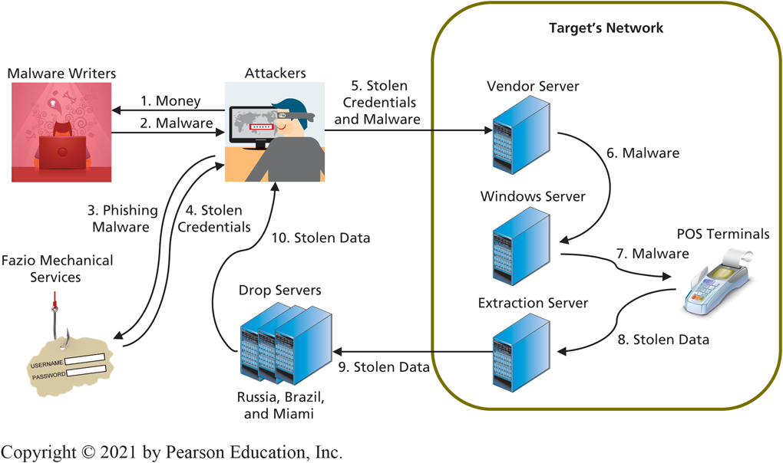
How Did They Do It?
Case Study 10
Bought malware
Spear-phished users at Fazio to get login credentials on Target vendor server.
Attackers escalated privileges, accessed Target’s internal network, and planted malware.
Trojan.P O S R A M extracted data from P O S terminals.
Sent data to drop servers
Figure 10-18 Target Data Breach

Slide 45
Damage (1 of 2)
Case Study 10
Card and pin numbers of 2 million cards for $26.85 each ($53.7M).
Costs
Upgraded P O S terminals to support chip-and-pin cards,
Increased insurance premiums,
Paid legal fees,
Settled with credit card processors,
Paid consumer credit monitoring,
Paid regulatory fines.

Slide 46
Damage (2 of 2)
Case Study 10
Loss of customer confidence and drop in revenues (46% loss for quarter).
Direct loss to Target as high as $450 million.
C I O resigned, C E O paid $16 million to leave.
Cost credit unions and banks more than $200 million to issue new cards.
Insurers demand higher premiums, stricter controls, and more system auditing.
Consumers must watch their credit card statements, and fill out paperwork if fraudulent charges appear.

Slide 47

Copyright

